Slide 1
Screen Time Presentation
(Secondary)
Description: This editable presentation gives educators and school leaders a quick way to present information on “screen time” to their families. It is designed to disseminate site-specific information and to build community trust in a moment where K-12 screen use can be polarizing and controversial.
Directions: You are encouraged to heavily edit this presentation to fit the needs of your school. Please edit as you see fit. Speaker notes include explanations and connections to other materials in CoSN’s Screen Time Toolkit.

Slide 2
Add Your School Logo Here
Notes:
This deck is designed for schools and districts to edit, brand, and reformat according to their needs.
You may combine this with the Quick Facts for Families resource.

Slide 3

Screens
at [your school name here]

Slide 4
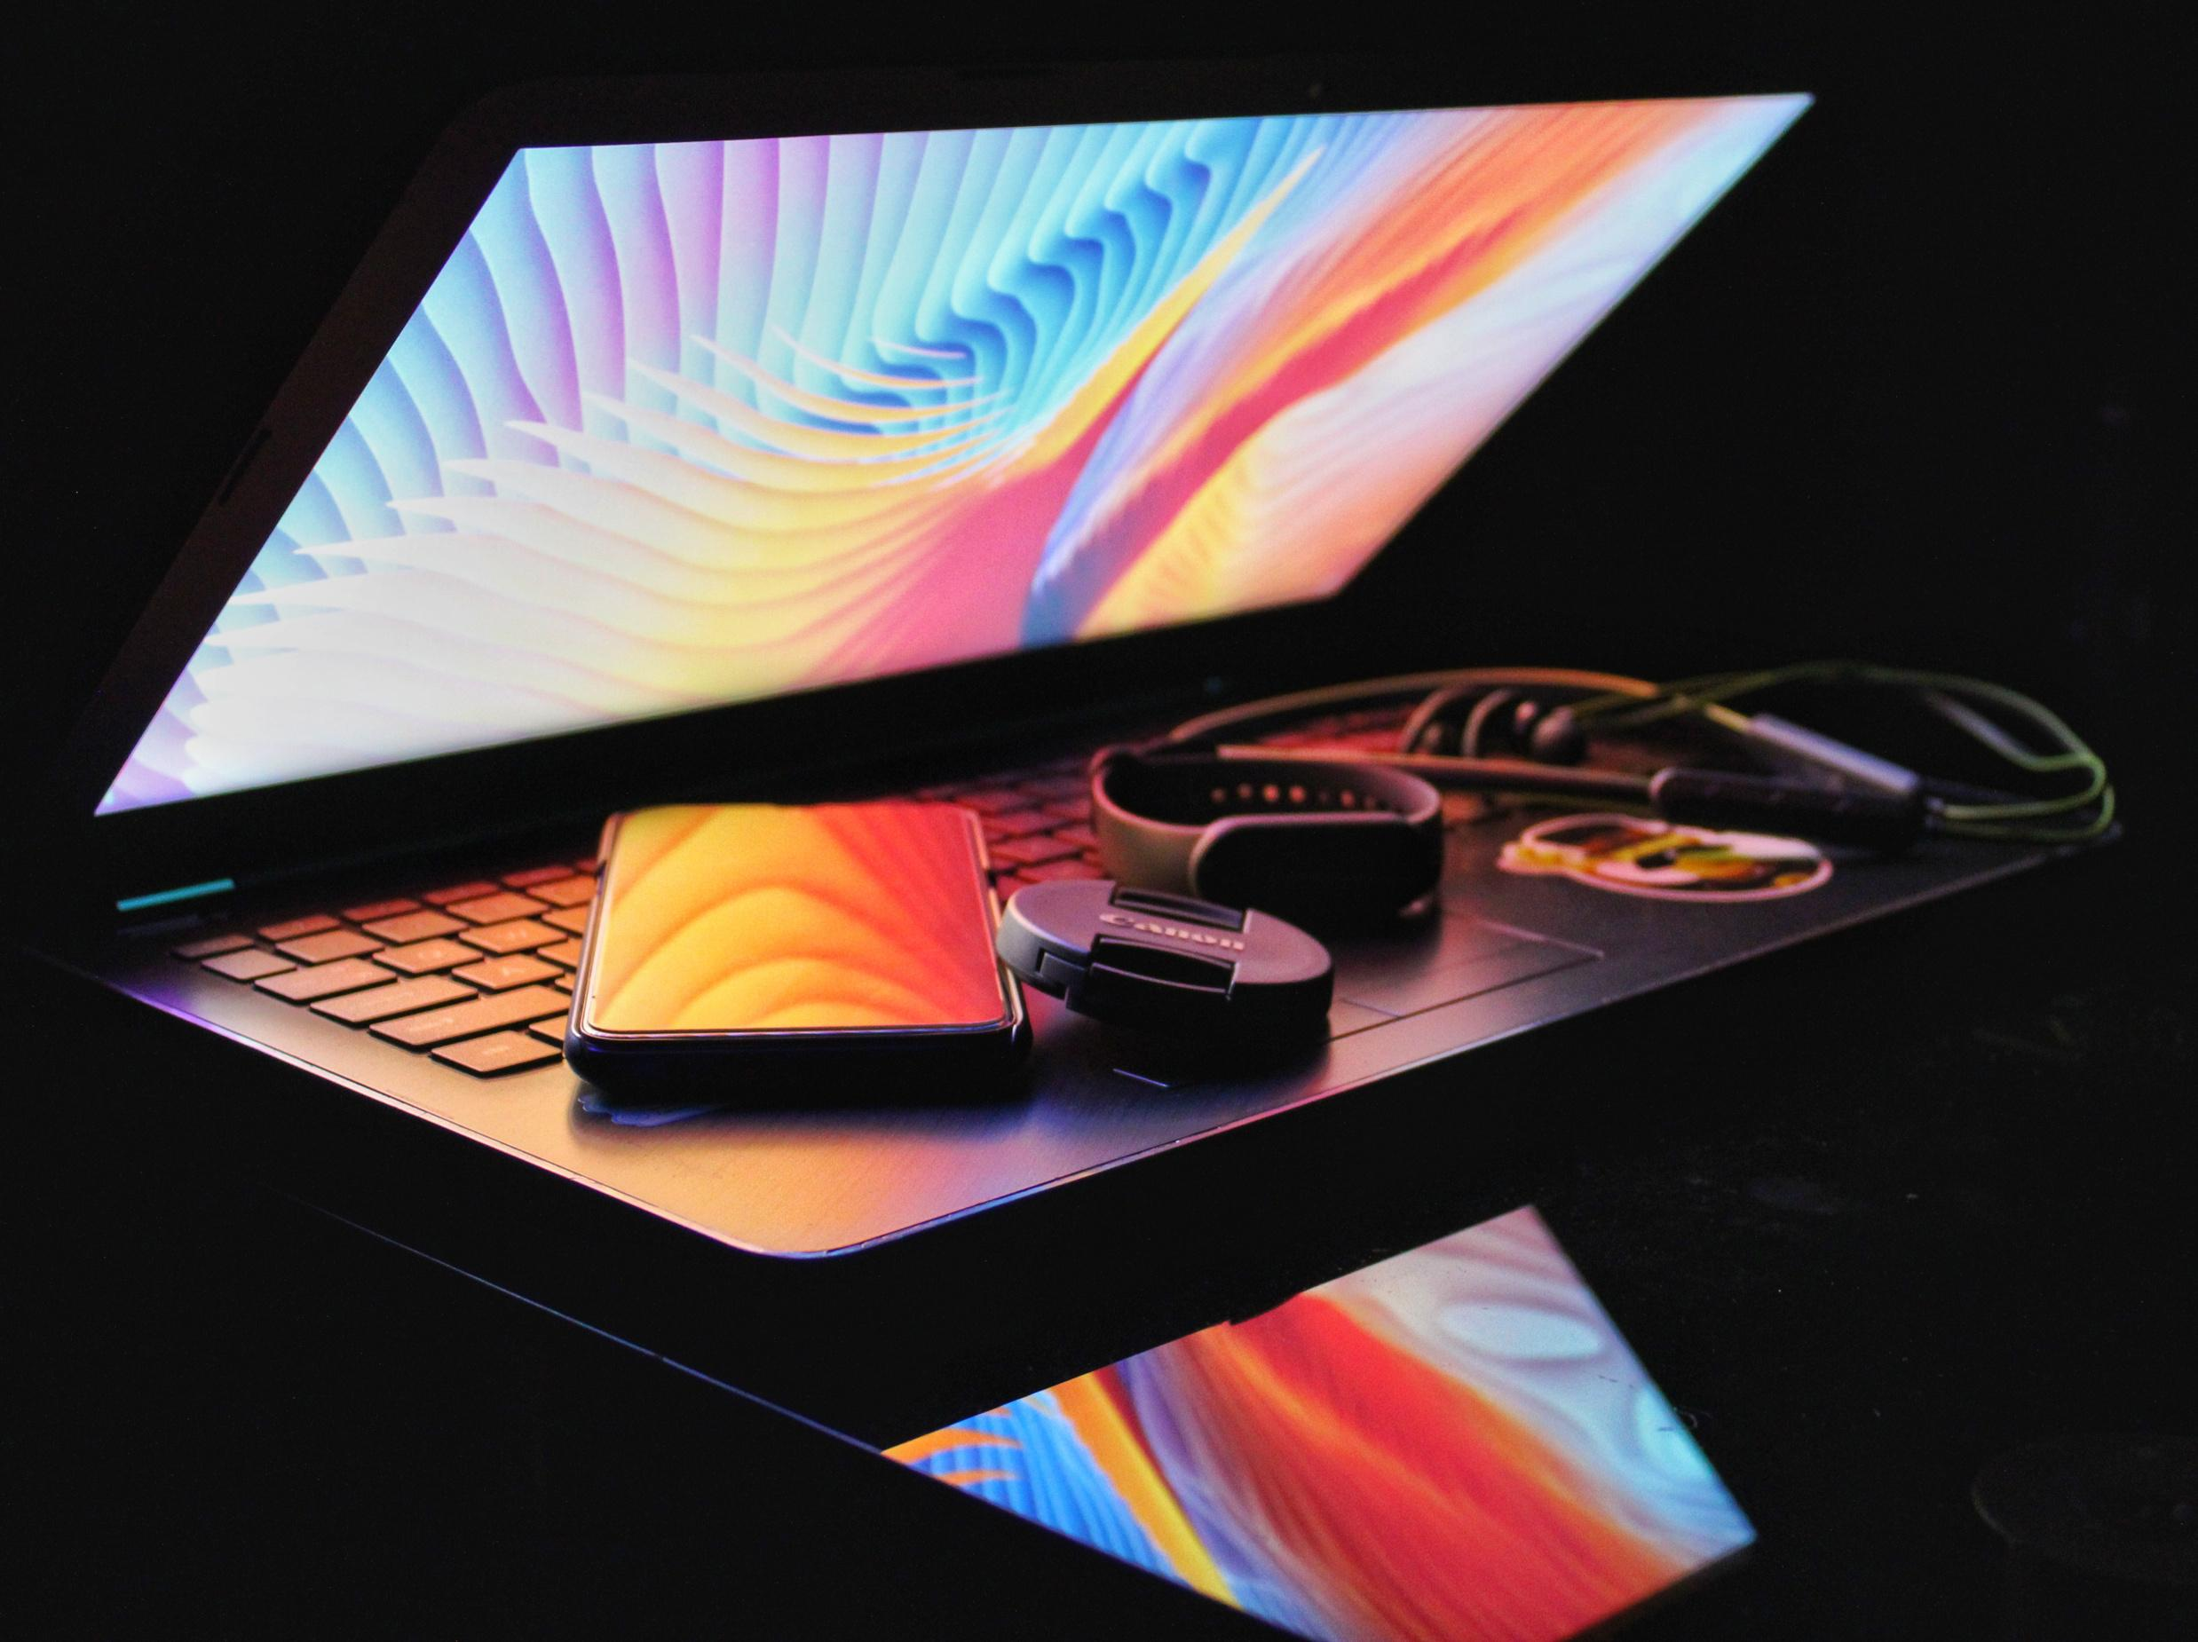
Agenda
Introductions
What IS screen time?
Screens at Home
Screens at School +
Cell Phone Policy
Collaboration/Resources

Slide 5



Who Are We?
John Doe
Jane Smith
John Doe
Principal
CTO
Principal
Favorite Candy: Snickers
Favorite Candy: M&Ms
Favorite Candy: Snickers
John Doe
John Doe
John Doe
Principal
Principal
Principal
Favorite Candy: Snickers
Favorite Candy: Snickers
Favorite Candy: Snickers
Notes:
Insert photos, names, and trivia about presenters and/or school leaders.

Slide 6


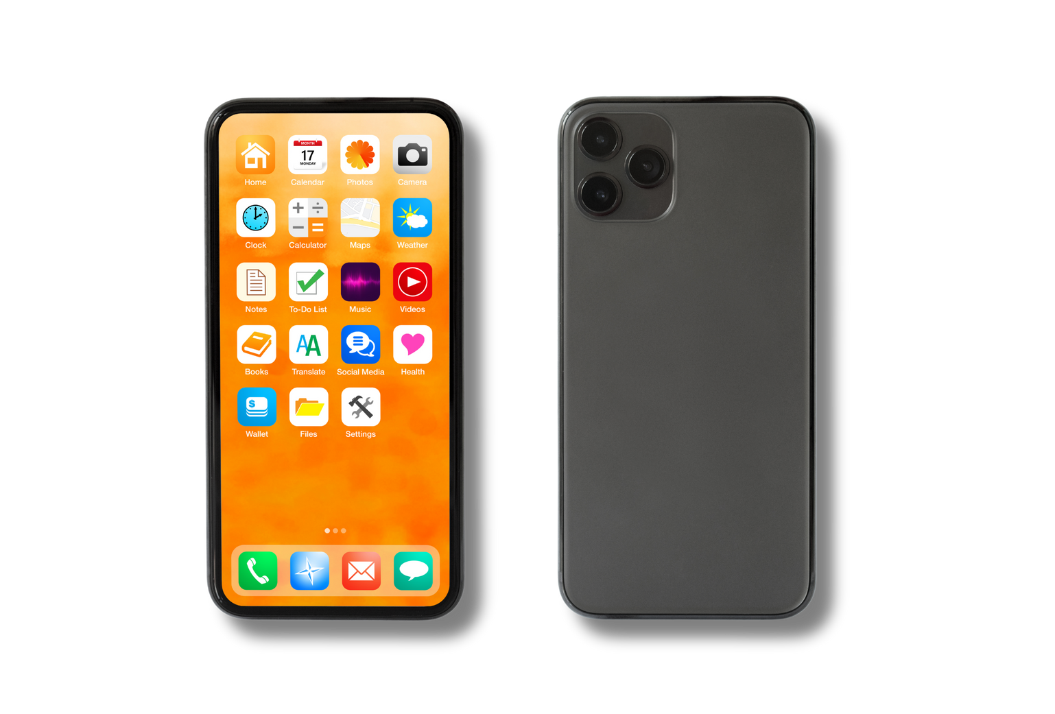
What IS
screen time?
Notes:
“Screen Time” is a major topic with an amorphous definition. Before talking about screens at school, it is important to clarify WHAT screen time is and WHY the conversation needs nuance.

Slide 7
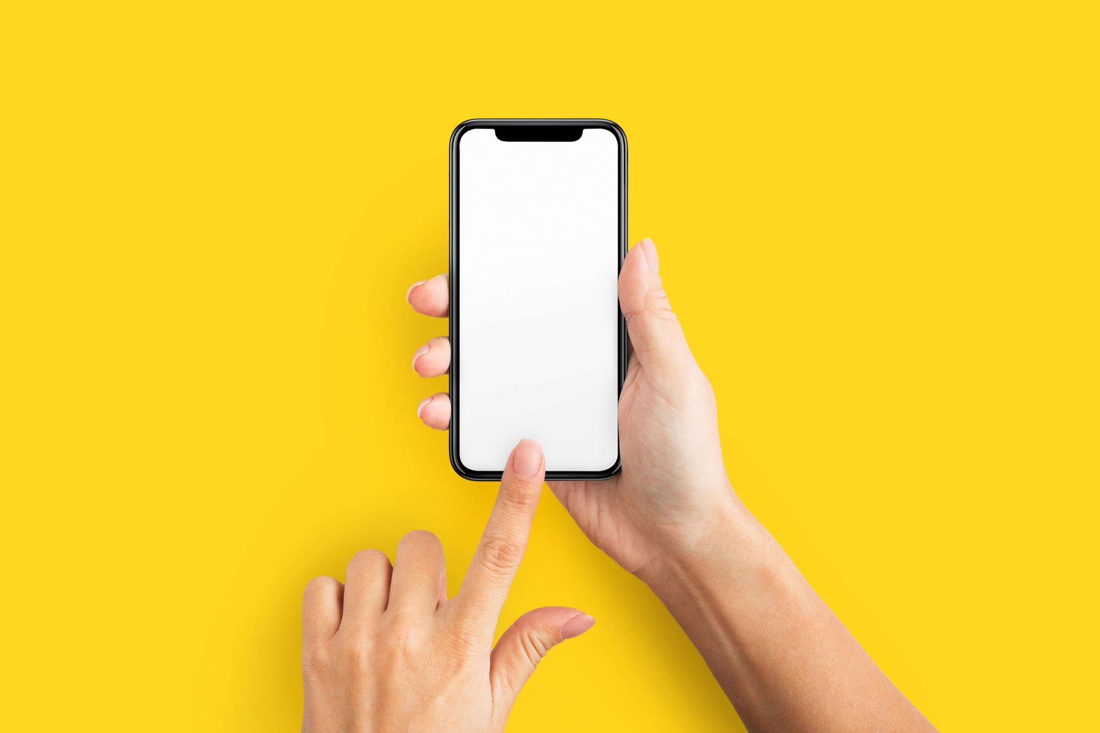

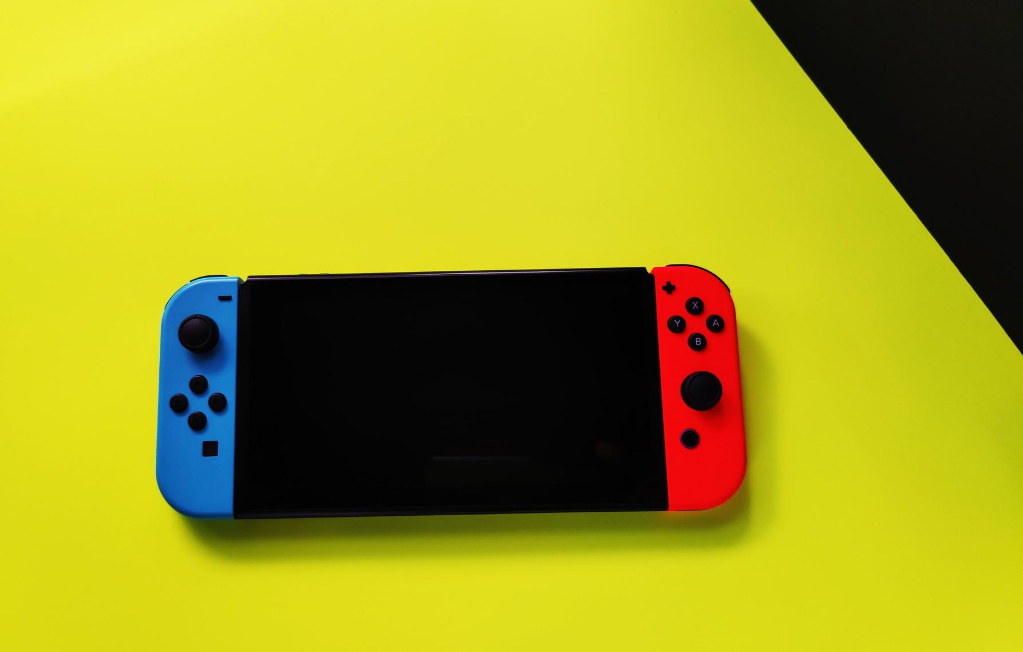
Three Types of “Screen Time”
Cell Phones
& Social Media
EdTech
  Used to support student learning.
  Used in ADDITION to high quality teaching.
  Designed to deepen content knowledge AND build 21st-century skills.
  Designed to incentivize consistent user engagement.
  Can serve as a significant distraction.
  Subject of recent legislation in most U.S. states.
Entertainment
  Refers to platforms NOT accessed primarily on a cell phone.
  Includes video games, television, and desktop computers.
Notes:
These “Three Types of Screen Time” represent the most relevant ways that screens are used by K-12 students.
See also: Refining the Conversation Infographic

Slide 8


Screen use can be beneficial to children AND adults if it is structured and intentional.
Notes:
STRUCTURE and INTENTION differentiate EdTech use from other popular uses for screens (e.g. social media). What students do in the classroom is chosen with care, is pedagogically sound, and employs clear guardrails to prevent overeliance.

Slide 9
Structured
and Intentional
Unstructured and Unintentional
  Used for a clear purpose (including leisure!).
  Used alongside in-person experiences.
  Used to target specific skills.
  Mindless scrolling.
  Multiple hours without breaks.
  Used as a replacement for in-person activities.
Notes:
See Also: Screen Time Continuum Infographic

Slide 10
Screens in
Our School

Slide 11

Why We Use EdTech
Students are able to engage with activities and lessons that are engaging, personalized, and targets the concepts they are developing.
Differentiation
Skill-Building
EdTech allows students to build and maintain important 21st-century skills that they will need beyond their K–12 education.
Access and Inclusion
EdTech allows greater access to grade-level academics to ALL students, including those in special education and English-learner programs.

Slide 12






EdTech at [Your School Name]
1:1 Devices
Coding Software
Art Program
All Subjects,
All Grades
Computer Science,
Grades 9–10
Creative Thinking, All Grades
Device/Program
Device/Program
Device/Program
Subject/Grade
Subject/Grade
Subject/Grade
Notes:
Insert ALL relevant programs, devices, and initiatives that your school uses. You may need to make a copy of this slide and add more.

Slide 13
EdTech has been proven to be a great supplement to high-quality teaching!
Notes:
Relevant research can be found in the Educator Two-Pager.

Slide 14
Screens at Home

Slide 15
Cell Phone Policy
Insert local/state cell phone policy here.

Slide 16
Our teachers use technology with intention, and you can, too!
Notes:
You may want to highlight the professional development initiatives that have trained staff to use EdTech thoughtfully and intentionally.

Slide 17
Research-Backed Recommendations
  Model thoughtful technology and cell phone use around your child.
  Create clear, consistent expectations for technology use (e.g. one television episode on weeknights).
  Monitor what your child is accessing on their devices.
  Provide engaging in-person experiences for your child.
  Remember that there is no one correct way to use technology. Do what works best for your family.
Notes:
Relevant research can be found in the Educator Two-Pager.

Slide 18
Teaching students how to thoughtfully use screens NOW will affect their relationship with technology for the rest of their lives!
Notes:
This slide may be used to discuss your school’s role in preparing students for technology’s inevitable use in daily life.

Slide 19
Connecting School to Home!

Slide 20
Collaborate with Us!
_________ School Can
Your Family Can
Share Resources
Ask Questions
We have many EdTech resources that can be used at home! Find them at:
Don’t be shy! Anyone on our staff would be happy to help answer any questions you have related to our use of screens in classrooms.
Provide Meaningful Guidance
Share Personal Expectations
Your child’s teacher is an expert on education and child development! They are able to provide thoughtful, personalized recommendations on technology and education.
You are the expert on YOUR FAMILY! What are your family’s technology goals? How do you want to balance screen use and school expectations? We want to know!

Slide 21
Resources
  Outdoor Activity Guide to Local Public Parks
  AI and Accessibility | CoSN
  Screen Time Guide | Common Sense Media
  Resource/Authors
  Resource/Authors
  Resource/Authors
  Resource/Authors
  Resource/Authors
Notes:
Use this slide to insert any relevant resources, local or national, that you would like to advertise to families.
CoSN will have a version of this slide featuring relevant resources from partnering organizations.

Slide 22
Contact Us
John Doe
Jane Smith
John Doe
Principal
CTO
Principal
Number/Email
Number/Email
Number/Email
John Doe
John Doe
John Doe
Principal
Principal
Principal
Number/Email
Number/Email
Number/Email
Notes:
Edit this slide to include your presenters and other relevant staff.

Slide 23

Thank You!
Questions?

