Slide 1
Interoper…what?!
Discussion Slides

Slide 2
How to use these slides
This bank of slides are designed for a non-technical audience.
There are 5 sections to pull from:
Statistics
Text & Graphics
Quotes
Costs
Project Unicorn
Just grab what you need and go! Edit and reformat as needed.
Questions or would like CoSN to add a slide? email communications@cosn.org

Slide 3
Statistics

Slide 4
CTOs say improved interoperability will help them with:
Making State & Federal reporting more efficient (97%)
Building better district level dashboards (97%)
Accessing Digital Content (95%)
Scheduling/Rostering (94%)
Better understanding of the student learning process (91%)
Saving money (89%)
CoSN Infrastructure Survey
Notes:
In the recent CoSN infrastructure survey the overwhelming majority of districts said improved data interoperability would help them a myriad of challenges
Topping the list with 97% are—Making State & Federal reporting more efficient AND Building better district level dashboards
Also on the list are… accessing Digital Content (95%)
Scheduling/Rostering (94%)
Better understanding of the student learning process (91%)
and
Saving money (89%)
For the full list see the CoSN 2018-2019 Infrastructure Survey Report
Curious, did any of you take the CoSN survey? If you want you can me your email if you think your district was missed, we’ll get you on the distribution, Note we vet so there is only one response per district.

Slide 5
74% of schools
use more than 26 different edtech or software tools
Notes:
Digital Promise League of Innovative Schools’
Data Interoperability Working Group, 74% of school districts use more than 26 different
edtech or software tools

Slide 6
Interoperability impacts teachers
93% of all teachers now use some sort of digital tool to help guide instruction
67% of teachers are not fully satisfied with the effectiveness of the data and tools they have access to on a regular basis
Teachers spend approximately 9 additional hours per week on instructional workflow outside of school hours.
Teachers Know Best research project

Slide 7
30% of helpdesk calls
are for password resets

Slide 8
Text & Graphics

Slide 9
What is interoperability?
The seamless sharing of data, content and services among systems or applications.
An analogous situation exists in districts’ digital ecosystems.
Most edtech systems were not designed to work together.
Notes:
Anyone who’s traveled overseas and didn’t bring a power adapter understands interoperability, or rather the lack of it!

Slide 10
Why does interoperability in
K-12 matter?
Siloed data
Difficulties in student rostering
Inaccuracies in data transfer
End-user frustration of managing multiple log-ins
Unnecessary and costly expense retrofitting solutions together
Notes:
Unless we solve the interoperability challenge, the education sector will continue to have

Slide 11
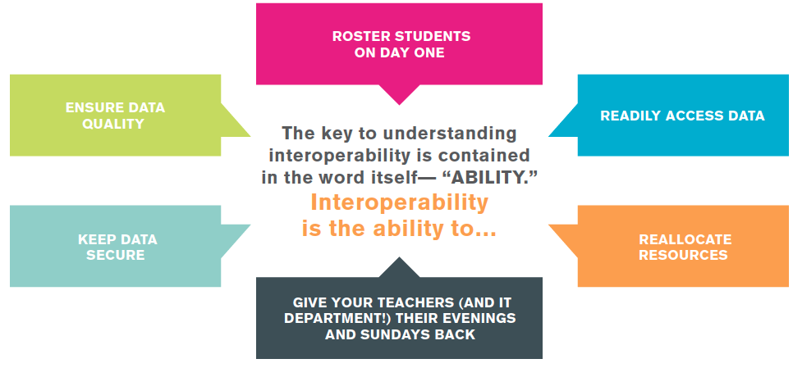

Slide 12
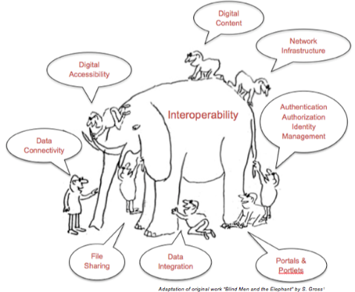
While there are different kinds of interoperability, they are all part of a much larger animal!

Slide 13
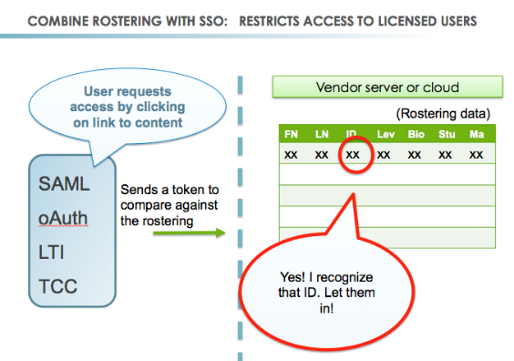

Slide 14
Quotes

Slide 15
“
”
You can’t realize the potential of data if you can’t get to the data.
Keith R. Krueger | CEO | Consortium for School Networking

Slide 16
“
Siloed efforts are not going to have the impact on learning that we desperately need. Instead, standards allow us to innovate on a common foundation, and create an ecosystem that connects learning experiences across contexts and across lifetimes.
Erin Knight | Senior Director of Learning and Badges | Mozilla Open Badges
”

Slide 17
“
The textbook industry has evolved to support a few common trim sizes for books and the bookstores have built shelves to fit them. The Common Cartridge is a similar convention applied to eLearning content.
Ray Henderson | Edtech Investor / Advisor
”

Slide 18
“
The ultimate goal is to use advanced technologies to support educators in personalizing instruction to meet each student’s individualized learning needs with differentiated content, assessments for learning, project-based ePortfolios, and online learning.
Dr. Susan Patrick | President and CEO | iNACOL
”

Slide 19
“
Getting out of the paper-centric world and into a world where content is truly born digital means that it can also be
born accessible and accessed through the tools that best suit
the needs of the individual student.
Betsy Beaumon | General Manager & VP, Global Literacy Program | Benetech
”
Notes:
This is only achievable when the curriculum content, assessments, and the wide array of reading and learning platforms all conform to the same interoperable standards.

Slide 20
“
Why it takes so long is because:
I am taking the standards from the report card,
I put them in a spreadsheet,
I print out the spreadsheet
I input all the kids’ names,
I print out the spreadsheet with all their names on it.
As I’m assessing them, and talking to them, and working with them, I’m filling in the spreadsheet.
And FINALLY, I take my hand-written spreadsheet to the computer, and input all the grades.
Research Participant | The Teacher Knows Best research project
”

Slide 21
“
So when we don’t privilege interoperability, when we don’t privilege products that allow us to get our data out, it means that in the end, we’re actually paying for access to our data, not just in teacher time and student learning, but actual money. This is our students’ data,
and we need to take it back in a way that empowers instruction.
Erin Mote | CEO | InnovateEDU
”

Slide 22
Costs

Slide 23

What does the lack of interoperability Cost?
Notes:
We all have the tactic knowledge that lack of interoperability costs districts money and time…which translate to money.
School district bear the financial burden of systems that don’t seamlessly connect and share data.

Slide 24
Hidden cost of not having interoperability
The service contract with our SIS to clean data
Fees for data integration solutions
Increase in software prices that gets passed along when vendors have to use or create integration services
Costs of consultants and IT department efforts to keep systems running

Slide 25
Michigan ROI study
$61 million per year were being spent on data quality, data completeness & other data management tasks
$64 million per year were being spent on system connections
$38 million per year were being spent on compliance data submissions
In total, this represents district expenditures of upward of $163 million per year
Notes:
Michigan took a close look at those costs via a comprehensive statewide study on interoperability. They did the math on what the LACK of interoperability is costing the state in terms of required personnel effort and technology data management solutions.
in the study they found …
$61 million dollars PER year were being spent on data qualyt , data completeness and other data management tasks
$64 million dollars PER year were being spent on system connections
$38 million dollars PER year were being spent on compliance data submissions
In total, this represents district expenditures of upward of $163 million PER year.
CoSN was not involved in this study…I just happen to attend a SETDA webinar when results were presented. .And it was the inspiration to create a tool that would help districts at least start to ballpark costs due to the lack of interoperability…either for existing systems or as they vet new systems that need to be integrated.

Slide 26
Project Unicorn

Slide 27

Notes:
Project Unicorn is an initiative to improve data interoperability within K-12 Education. It’s an alliance of many organizations in the K12 sector and CoSN is a member of the steering committee.

Slide 28
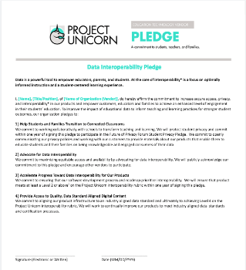
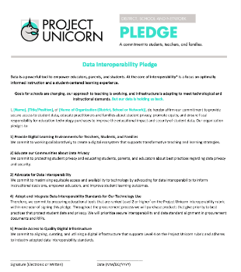
Project Unicorn Pledges
Notes:
Project unicorn launched with a district pledge.
The intent to signal a district’s commitment to improve both the security and impact of student data.
They have since added a pledge specific to vendors to do the same.

Slide 29
District Pledge Tenants
Provide digital learning environments for teachers, students, and families
Educate our communities about data privacy
Advocate for data interoperability
Adopt and integrate data interoperability standards for our technology use
Provide access to quality digital infrastructure
Notes:
There 5 key tenants included in the district pledge:
Provide digital learning environments for teachers, students, and families
Educate our communities about data privacy
Advocate for data interoperability
Adopt and integrate data interoperability standards for our technology use
Provide access to quality digital infrastructure
CoSN encourages members and all districts to demonstrate their commitment to providing secure access to student data and improving the educational impact by signing the Project Unicorn pledge.

Slide 30
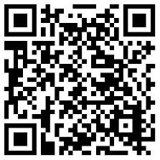
bit.ly/Unicorn_Pledge
Notes:
Here’s the direct link to the district pledge

